Slide 1


Ontology based Instance Matching
Vivek R. Shivaprabhu
CS 586: Data and Web Semantics | Fall 2016

Slide 2
Papers covered
Castano, Silvana, et al. "Ontology and instance matching." Knowledge-driven multimedia information extraction and ontology evolution. Springer Berlin Heidelberg, 2011. 167-195.
Daskalaki, Evangelia, et al. "Instance matching benchmarks in the era of Linked Data." Web Semantics: Science, Services and Agents on the World Wide Web 39 (2016): 1-14.
Rong, Shu, et al. "A machine learning approach for instance matching based on similarity metrics." International Semantic Web Conference. Springer Berlin Heidelberg, 2012.
Euzenat, Jérôme, and Pavel Shvaiko. Ontology matching. Vol. 18. Heidelberg: Springer, 2007.
Bizer, Christian. "Evolving the Web into a Global Data Space." BNCOD. Vol. 7051. 2011.

Slide 3
Agenda
Introduction, Initiatives
Concepts
Matching Techniques
Benchmark Design for Instance Matching
Work with the City of Chicago

Slide 4
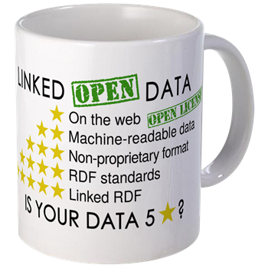
Introduction
Big Data and the explosion of the amount of available data
User generated content – status messages, tweets, reviews, etc
Content from sensors – GPS, weather, health tracking, etc
Semantic Web and the need to organize data
Linked Data paradigm
Unconstrained publication of information by different publishers
Interlinking of Web resources – same-as interlinking
$13.19
Notes:
The growing need of sharing data and digital resources within and across organizations has produced a novel attention on issues related to ontology and instance matching.
Existing solutions have reached a certain degree of maturity and they address a number of general requirements, such as the applicability to different ontology specification languages, the capability to deal with different levels of detail in describing the knowledge of interest, and the necessity to automate as much as possible the matching execution.
Ontology matching approaches and tools are getting more and more important in the framework of Semantic Web applications, where not only conventional matching at the schema level, but also and especially matching at the instance level is becoming essential to support discovery and management of different individual descriptions referring to the same real-world entity.
The Linked Data paradigm is based on the unconstrained publication of information by different publishers, and the interlinking of Web resources.
The “same-as” type of identification is not explicit in the dataset and must be automatically determined using instance matching tools.

Slide 5
Initiatives
Linking Open Data – lod-cloud.net
Publish various open data sets as RDF on the Web
Setting RDF links between data items from different data sources
180 datasets altogether having a size of around 20 billion RDF triples
Ontology Alignment Evaluation Initiative – oaei.ontologymatching.org
Define consensus for evaluation of methods available for schema or ontology matching
Yearly evaluation events
Bootstrapping Ontology Evolution with Multimedia Information Extraction - mklab.iti.gr/projects/boemie

Slide 6
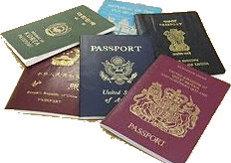
Also known as…
Instance Matching
Record Linkage
Duplicate Detection
Entity Resolution
Deduplication
Merge-Purge
Entity-Identification
Object Identification
Data Fusion
Identity Resolution
Fun fact:
Tim Berners-Lee, director of the W3C, coined the term “Linked Data” in a 2006 design note about the Semantic Web project.
www.w3.org/DesignIssues/LinkedData.html

Slide 7

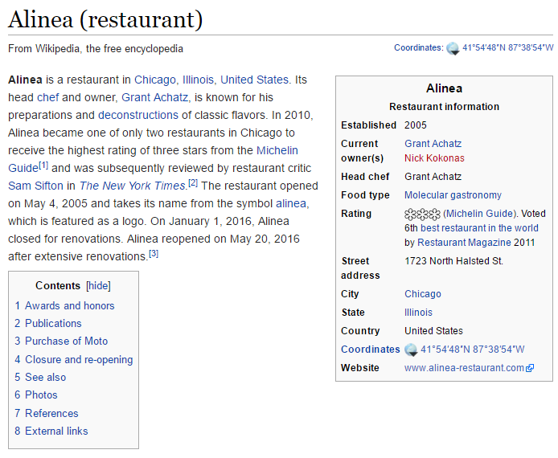
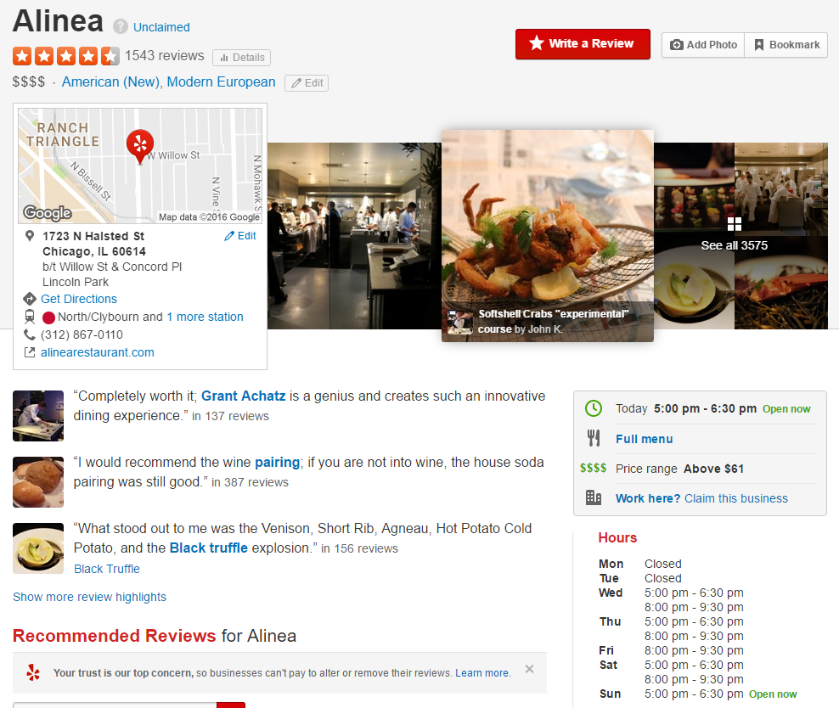
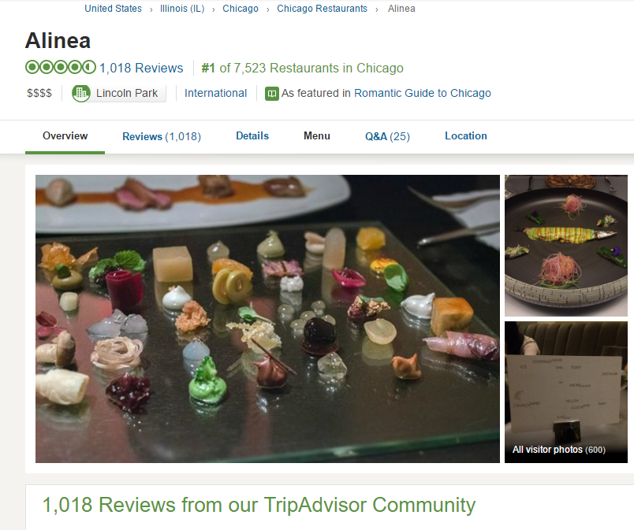

Need for instance matching

Slide 8
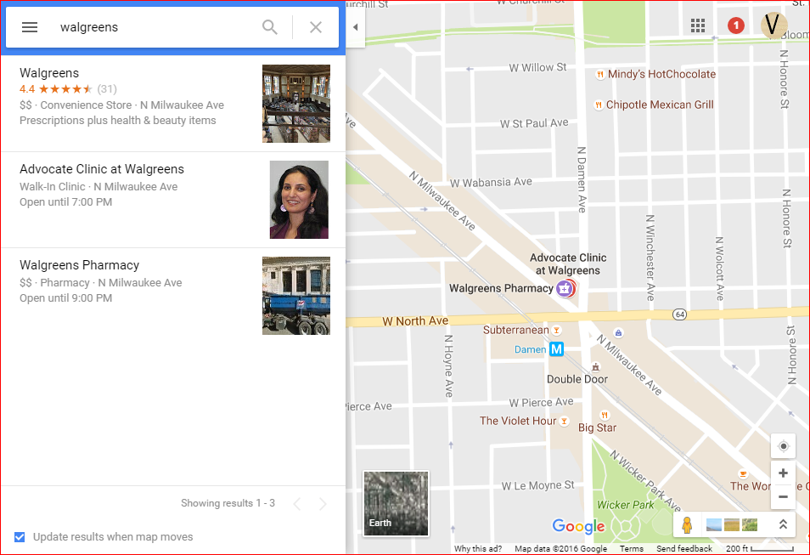
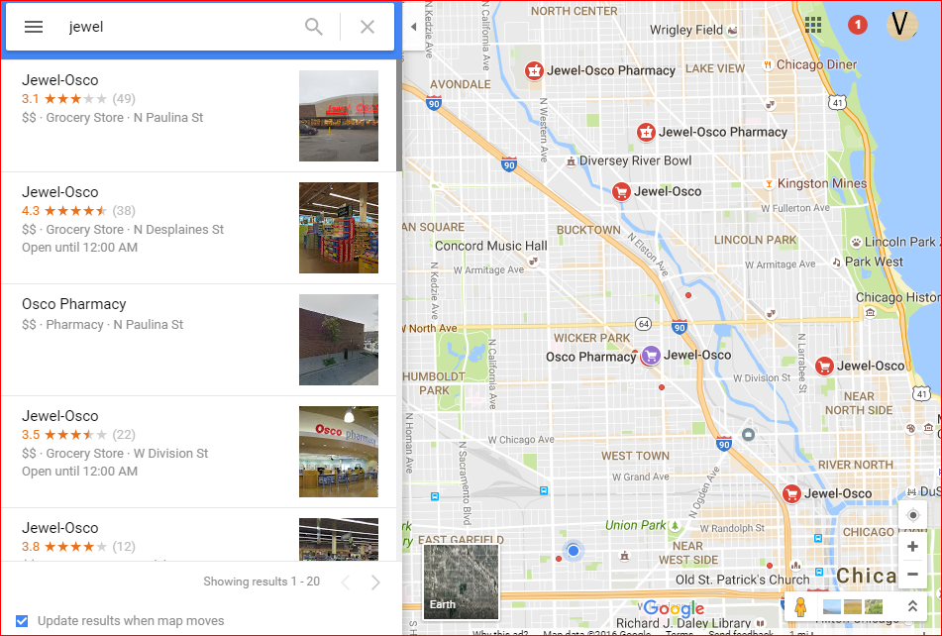
Need for instance matching

Slide 9
Concepts - Agenda
Description Logic – an overview
Identity Resolution, Similarity Recognition
Schema Matching - Techniques
Instance Matching - Techniques
vs Record Linkage
Ontology Matching

Slide 10
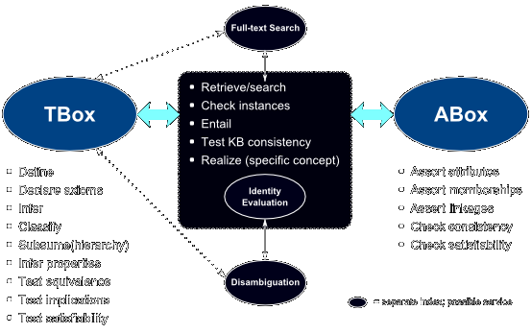
Description Logic (DL) – an overview
Family of formal knowledge representation languages
Used to describe and reason about concepts of an application domain (terminological knowledge)
TBox (terminological box)
Contains statements describing relations between concepts (hierarchies)
Ex: Every employee is a person
Abox (assertional box)
Contains ground sentences that describe relations between individuals and concepts
Ex: Bob is an employee
http://wiki.opensemanticframework.org/index.php/Ontologies:_Basic_Groundings

Slide 11
Identity Resolution
Instances describe the same real-world entity
Used to join data sets that may or may not share a common identifier (URI, Key, ID, etc)
Match data from myriad record shapes, storage locations and/or styles
Data Set | # | SSN | Name | DOB | Sex | ZIP
Set A | 1 | 000956723 | Smith, William | 1973/01/02 | Male | 94701
 | 2 | 000956723 | Smith, William | 1973/01/02 | Male | 94703
 | 3 | 000005555 | Jones, Robert | 1942/08/14 | Male | 94701
 | 4 | 123001234 | Sue, Mary | 1972/11/19 | Female | 94109
Set B | 1 | 000005555 | Jones, Bob | 1942/08/14
 | 2 |  | Smith, Bill | 1973/01/02 | Male | 94701

Slide 12
Similarity Recognition
Evaluate the degree of similarity between two instances
Instances describe different real-world entities
Set A |  |  | Set B |  |  | Similarity
Title | Subject | Author | Title | Subject | Author
The Sun Shines Bright (book) | Essay collections by Isaac Asimov | Isaac Asimov | Quasar, Quasar, Burning Bright | Essay collections by Isaac Asimov | Isaac Asimov | 0.99
Delitto in cielo | Hercule Poirot novels | Agatha Christie | Tragedia in tre atti | Hercule Poirot novels | Agatha Christie | 0.84
http://oaei.ontologymatching.org/2014/im/index.html

Slide 13
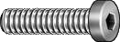
Schema Matching vs Instance Matching
Schema Matching, aka Concept Matching
Instance Matching
Matching of concepts and properties represented by TBoxes of DL ontologies
Matching of assertions represented by ABoxes of DL ontologies
DB1.Product | DB2.Product
ID | Item Number
Description | Web Description
Brand Name | Trade Name
Material
 | Finish
Overall Length | OAL
¼-20 x 3/8 SS SHCS
Stainless Steel Socket Head Cap Screw, 1/4” Dia, 20 Thread Size, 3/8” Length

Slide 14
Schema Matching Techniques
Similarity Based – measure the degree of similarity of two concepts
Linguistic
Syntactic – string structure – using edit-distance, automata, bit-parallelism, filtering
Semantic – meaning – using synonyms, hypernym/hyponym, dictionaries, thesauri
Contextual
Matching based on properties, semantic relations, taxonomies, etc. Ex: using graph matching
Reasoning Based – inference problem involving two ontologies and an initial set of mappings
Deductive – derive candidate mappings from the initial set of mappings and test satisfiability
Probabilistic – calculate the probability that two concepts are similar or have same instances

Slide 15
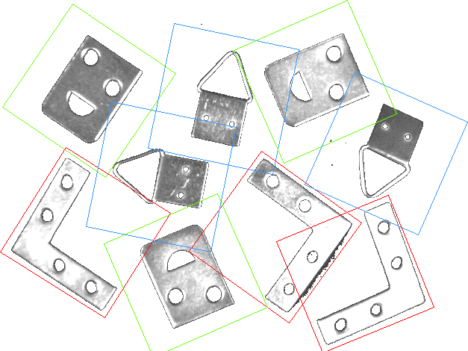
Instance Matching
Similar to Record Linkage and Data Deduplication
Value-oriented techniques
Record-oriented techniques
Goal:
given r_{i} = [v₁,...,v_{m}], m: # attributes,
for a pair of records r₁ and r₂, to find
the overall similarity Sim(r₁, r₂) is composed of
the similarities Sim(v_{k1}, v_{k2}), k: 1..m
to determine if r₁ and r₂ are the same real world entity

Slide 16
Instance Matching: Record-oriented techniques
Learning based – train a classifier
Requires high-quality balanced training data
Supervised learning using SMEs, or
Unsupervised methods such as clustering
Combined/hybrid methods
Similarity based
Using weighted similarity measures across multiple properties; weights can be assigned by a domain expert or using statistical analysis
Identifying a threshold to distinguish the matches is difficult
Rule based
Special case of Similarity based techniques
Uses rules that are defined by domain experts
Yields precise matching results
Matcher is domain specific
Prior knowledge and expertise is required
Context based
Matching by considering attribute values as well as their relationships with other records (friends)
Using a collective model using records from multiple sources by considering shared attribute values

Slide 17
Instance Matching vs Record Linkage
Structural Heterogeneity
Language Expressivity – structurally different, but semantically equivalent
Design Practices – myriad methodologies for ontology design are available, but consolidated and widely accepted design patterns are missing
Implicit Knowledge
Information inferred from the parent-child relationships represented in the hierarchical representation of ontologies
ID oriented identification
Using URI or other identifier to refer to an instance simplifies insertion and retrieval
This provides syntactic instance identification, but it is useless for instance matching to determine when different instance identifiers refer to the same real-world entity

Slide 18
Ontology Matching
Matching ontological knowledge in general
both TBoxes and ABoxes
Usually performed semi-automatically
Find classes of data that are semantically equivalent (ex: Truck and Lorry)
Three major dimensions for similarity: [2]
Syntactic – value heterogeneity
External – structural heterogeneity
Semantic – logical heterogeneity
Matching for lightweight integration
Typically suited for web-scale, semantic web, and p2p environments
Flexible schema and instance mapping techniques are required by each peer for discovery
Matching for semantic coordination
Techniques and tools to effectively manage the large datasets shared between social networks and community-oriented collaboration platforms
Linguistic and instance matching are prominent to match poorly-structured or fully-unstructured data

Slide 19
Benchmark Design - Agenda
The need for evaluation
Linked open data
Benchmark design
Benchmark characteristics
Dataset, Reference Alignment, Evaluation Criteria
Future directions

Slide 20
The Need for Evaluation
Historically (past decade), instance matching has been well defined for relational data
Identifies differences between values of relational attributes
Little to no focus on structure or semantics
Linked Data are described by expressive schemas that carry rich semantics expressed as RDFS and OWL
Variations in the data sources are value, structural and logical [3]
When paired with a reasoning engine, Linked Data allows implicit relationships to be inferred from the data (which was not possible with relational or XML data)
Instance matching systems designed for one type of data (ex: XML) may not be able to fully exploit the heterogeneities described in RDFS/OWL.
Benchmarks focus on methods’ ability to present differences in the nature of data – values and structure – as well as the semantic meaning they imply.

Slide 21
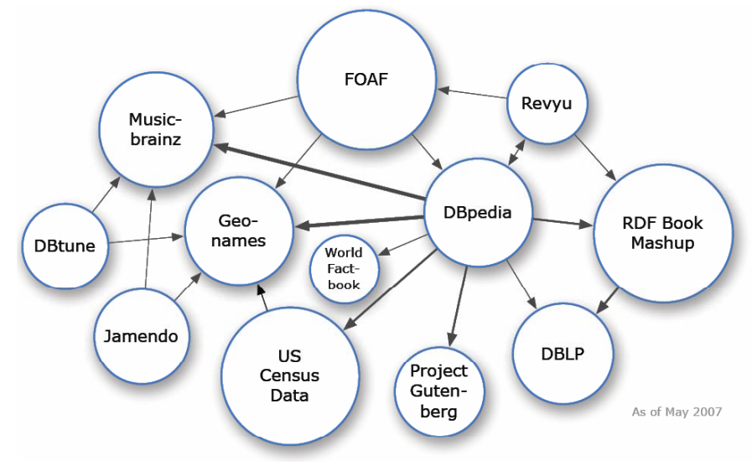
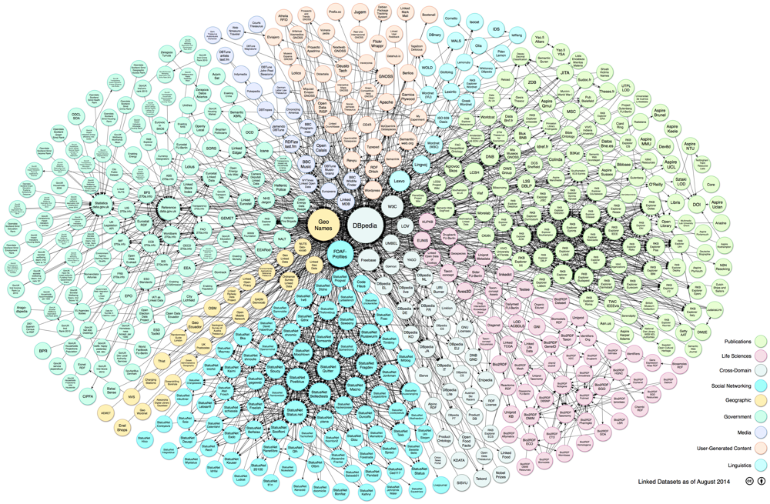
Linked Open Data – Then and Now
May 2007
Today
http://lod-cloud.net/

Slide 22
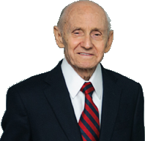
Benchmark Design
It is not easy to be the best. To try to be the best, identify weak points that can then be worked on and improved
Benchmarks help computer systems compare and assess performances
Importantly, it helps to push harder to get further
Results are a rough estimate of performance
It is only an indication of the effectiveness of what was tested
Do we need a benchmark to measure the effectiveness of the benchmark?
Benchmarking, from a philosophical point of view, is “the practice of being humble enough to admit that someone else is better at something and wise enough to try to learn how to match and even surpass them at it.”
– Jack Grayson, founder American Productivity & Quality Center
https://www.apqc.org/c-jackson-grayson

Slide 23

Benchmark Characteristics
Open and Accessible for all interested parties
Persistent over time
This rules out testing datasets like Dbpedia
Unbiased
Lack of standards leads to self-reported synthetic testing datasets and reports
Different test cases
contains source and target datasets,
the reference alignment, and
evaluation metrics
Notes:
Open means that they are free to use and accessible means that they are easily available to the interested parties.
Persistent means that the components of one benchmark should not evolve or change through time, so as to make the results of different systems (obtained at different times) comparable.
Unbiased means that there should not exist any conflict of interest between the creators of the benchmark and the creators of the system under test.

Slide 24
Dataset characteristics
Nature of Datasets
Real datasets – contain real data and can be used either as a whole or partly
+ Realistic conditions for addressing heterogeneity issues
+ Distributions that reflect real world situations
- Do not come with adequate reference alignments
Synthetic datasets – auto generated from scratch or using existing datasets
+ fully controlled test conditions
+ accurate reference alignments
+ allows setting the focus on specific types of heterogeneity problems in a systematic manner
- datasets produced usually come with unrealistic distributions
Notes:
Real datasets are those that contain real data and can be used either as a whole (i.e., the entire ontology with its instances) or partly (i.e., only a part of the ontology and the corresponding data instances, without any modifications). A manual or semiautomatic process of reference alignment creation must be undertaken, which often leads to incomplete or incorrect reference alignments.
Synthetic generators may be used to create a dataset from scratch (i.e., create new data based on a schema), or to create a dataset based on an existing datasets (multiply the existing instances).

Slide 25
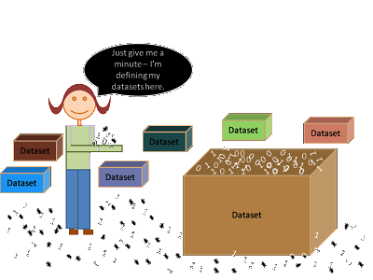
Dataset characteristics
Benchmark Schemas and Domains
Datasets can have:
the same schema (instance level matching only) or
different schemata (schema mapping is also considered)
Similarly for domains
Benchmark Variations
Variations between the matched instances
Value variations – date formats, abbreviations, multi-lingualism, etc
Structural variations – merged properties, datatypes, etc
Logical variations – RDFS/OWL language constructs

Slide 26
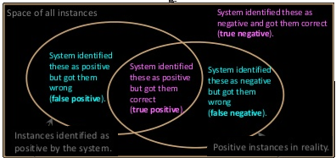
Benchmark characteristics
Reference Alignment
Evaluation Metrics
Aka, Ground Truth, or Gold Standard
Manually curated by SMEs, or
(Semi-) automatically generated using supervised systems or crowdsourcing
Time consuming and Error prone
If ‘same-as’ links already exist (ex: LOD), consider the problem of incompleteness
Determine and asses system behavior and performance
Benchmarks proposed by the Transaction Processing Council* (TPC) are most widely known
Performance and efficiency based
Quality – correct answers – is more important
Precision,
Recall, and
F-measure
*http://www.tpc.org/
Notes:
“correct answer sheet” of the benchmark is used to judge the completeness and soundness of the matched instances produced by the benchmarked matching algorithms.
Performance and Efficiency (e.g. throughput – source rows processed per second, transaction rate, transactions per second, Query-per-Hour Performance, etc.)

Slide 27
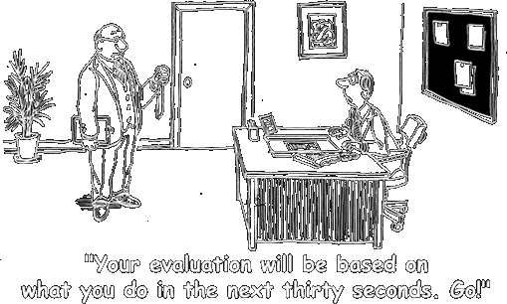
Benchmark Evaluation Criteria
Qualitative
Quantitative
Systematic Procedure – reproducible tasks
Quality – precise evaluation rules and ontologies
Equity – equal treatments of methods/systems
Reference Alignment – accuracy and completeness
Availability – datasets and reference alignment are always readily available for use by various systems
Dissemination – how many systems have used this benchmark for evaluation
Volume – size of the datasets; whether the benchmark also tests scalability
Datasets Variations – types and complexity of the variations that the datasets consider

Slide 28
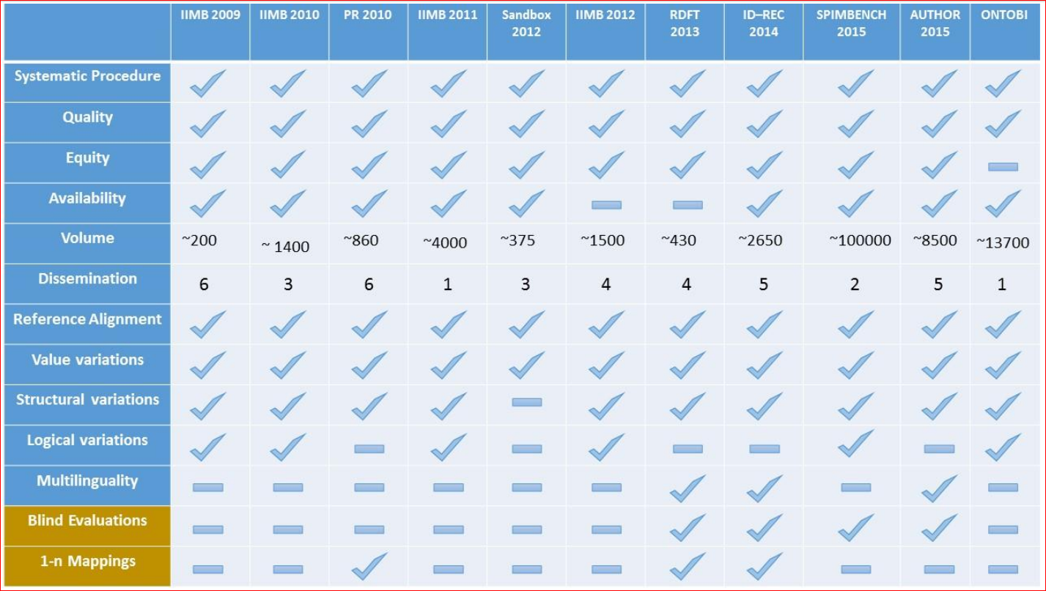
Synthetic Benchmarks
LOD has 570 datasets as of 2015
Billions of triples in some datasets

Slide 29
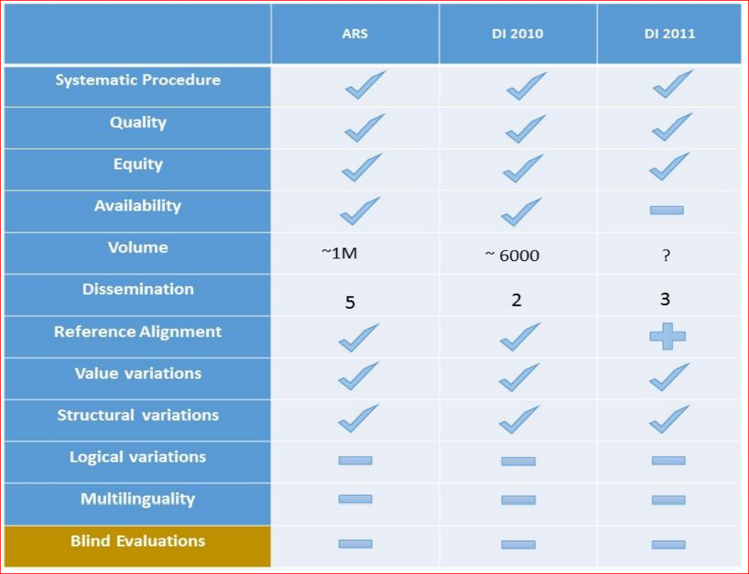
Real Benchmarks
The ability to provide a reliable, (semi-) automated error-free reference alignment for real datasets is an open issue for the research community

Slide 30
Future Benchmark Directions
Special domain specific data with specific characteristics
Geo-spatial – semantic and topological dimension as wells as information that descries the position, extension and shape and relationship between spatial features
Tempo-spatial data – time perplexes the facts of existence of places and/or names and their meanings
Triangular (or transitive) benchmarks that map three (or more) datasets
Instead of just source-to-target mappings

Slide 31
Project Work - Agenda
Business Names Matching with the City of Chicago
Similarity Measures
Initial Results

Slide 32
Business Names Matching for City of Chicago
Create a consolidated picture of a business by integrating data from myriad data sources.
Potential to create the Single Source of Truth by integrating various spoke systems.
Matching based on (ethereal) attributes such as Business Names and Addresses without relying on (identifying) attributes such as License Numbers.
Ability to scale up to new sources with ease.
Acme Corporation
Business Licenses
Food Inspections
Building Permits
Business Owners
...
Google places / businesses
Yelp ratings & reviews
...
* work in progress * next in line * third party sources

Slide 33
System Architecture
Text, XML, OWL, SQL
Data Models
Matchers
Other Data Model Factories...
Other Data Models...
Other similarity vectors
Acme Corporation
Business Licenses
Food Inspections
Food Inspections Factory
Food Inspections
Address similarity
Stream
Building Permits
Business Owners
I Business Model Factory
I Business Model
I Matcher / Similarity
...
Business Licenses Factory
Business Licenses
Business Name(s) similarity
Load
Google places
Yelp ratings & reviews
...

Slide 34
Similarity Measures
The following similarity measures are calculated for Legal and DBA Names from the two data sets:
String.equals
aml.ISub.similarity on the original legal and dba names
similar to the Levenshtein distance. This method is based on the length of common substrings
ISub similarity on 'cleaned' versions (remove all special characters) from names
aml.weighted Jaccard, where words are weighted by length
measure of the overlap that two strings A and B share with their component word parts
Stop words elimination is implemented, but not used
Acronym comparison is implemented, but not used due to too many false positives
Final similarity value = max value of these measures

Slide 35
Initial Results (1 of 2): Name + Address Matching
FoodInspection(InspectionID=1953735, LegalName=DUNKIN DONUTS, DoingBusinessAsName=DUNKIN DONUTS/BASKIN ROBBINS, Address=9100 S COMMERCIAL AVE , City=CHICAGO, State=IL, Zip=60617),
BusinessLicense(Id=2109876-20130916, LicenseId=2276758, LegalName=Gunatit Inc, DoingBusinessAsName=DUNKIN DONUT, Address=9100 S COMMERCIAL AVE 1, City=CHICAGO, State=IL, ZipCode=60617), NameSimilarity=0.976, AddressSimilarity=0.986, CityStateZipSimilarity=true)
BusinessLicense(Id=2109876-20110822, LicenseId=2109876, LegalName=Gunatit Inc, DoingBusinessAsName=DUNKIN DONUT, Address=9100 S COMMERCIAL AVE 1, City=CHICAGO, State=IL, ZipCode=60617), NameSimilarity=0.976, AddressSimilarity=0.986, CityStateZipSimilarity=true)
BusinessLicense(Id=2109876-20150916, LicenseId=2416718, LegalName=Gunatit Inc, DoingBusinessAsName=DUNKIN DONUT, Address=9100 S COMMERCIAL AVE 1, City=CHICAGO, State=IL, ZipCode=60617), NameSimilarity=0.976, AddressSimilarity=0.986, CityStateZipSimilarity=true)
...

Slide 36
Initial Results (2 of 2): Name + Address Matching
FoodInspection(InspectionID=1950927, LegalName=HAMBURGER MARY'S CHICAGO, DoingBusinessAsName= HAMBURGER MARY'S CHICAGO, Address=5400 N CLARK ST , City=CHICAGO, State=IL, Zip=60640),
BusinessLicense(Id=1677595-20060921, LicenseId=1677595, LegalName=THE BIG FOUR, LLC, DoingBusinessAsName=HAMBURGER MARY'S CHICAGO, Address=5400 N CLARK ST 2, City=CHICAGO, State=IL, ZipCode=60640), NameSimilarity=1.0, AddressSimilarity=0.981, CityStateZipSimilarity=true)
BusinessLicense(Id=1677596-20130716, LicenseId=2259674, LegalName=THE BIG FOUR, LLC, DoingBusinessAsName=HAMBURGER MARY'S CHICAGO, Address=5400 N CLARK ST 2, City=CHICAGO, State=IL, ZipCode=60640), NameSimilarity=1.0, AddressSimilarity=0.981, CityStateZipSimilarity=true)
BusinessLicense(Id=1598382-20060816, LicenseId=1735062, LegalName=THE BIG FOUR, LLC, DoingBusinessAsName=HAMBURGER MARY'S CHICAGO, Address=5400 N CLARK ST, City=CHICAGO, State=IL, ZipCode=60640), NameSimilarity=1.0, AddressSimilarity=1.0, CityStateZipSimilarity=true)
BusinessLicense(Id=1598381-20060525, LicenseId=1598381, LegalName=THE BIG FOUR, LLC, DoingBusinessAsName=HAMBURGER MARY'S CHICAGO, Address=5400 N CLARK ST, City=CHICAGO, State=IL, ZipCode=60640), NameSimilarity=1.0, AddressSimilarity=1.0, CityStateZipSimilarity=true)
...

Slide 37
Next steps
Business - to - Business matching to group multiple licenses into a single ‘entity’
Additional similarity measures to expand the match vector dimension
Start incorporating new data sets - both internal as well as third party resources

Slide 38
Thank you!
Discussion

